Slide 1

BIKE SALE’S PROJECT
MISS KOLAWOLE OLAITAN ADEOLA
3rd of September 2024

Slide 2
Agenda
1
2
3
4
5
Introduction
Business Task
Data Cleaning and Analysis
Dashboard
Summary

Slide 3

Introduction
In today’s presentation, we will explore a Bike Sales dataset sourced from Kaggle, which offers valuable insights into sales trends and customer behavior in the biking industry. The dataset contains 18 columns of detailed information, including:
Date: The transaction date.
Order Quantity: The number of bikes sold in each order.
Unit Price: The price per bike.
Month: The month of the transaction.
Country: The country where the purchase took place.
Revenue: The total revenue generated from sales.
Customer Age: The age of the customer.
Customer Gender: The gender of the customer.

Slide 4
BUSINESS TASK
Through this dataset, we aim to:
Understand sales trends across different time periods and regions.
Explore the relationship between pricing, order quantities, and total revenue.
Examine customer demographics (age, gender) to identify purchasing patterns.
Provide actionable insights for optimizing sales strategies in the biking market.
By the end of this project, we’ll uncover key factors that drive sales and customer behavior, helping businesses refine their marketing and sales tactics.

Slide 5
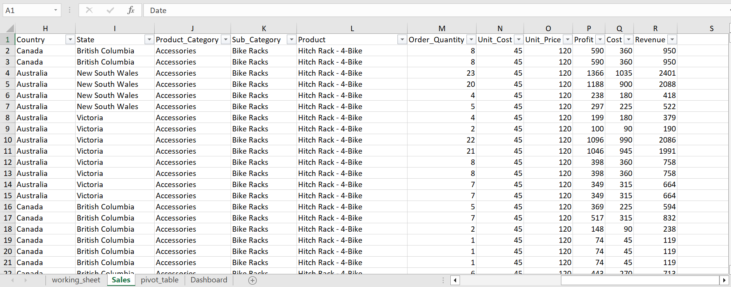
DATA PREPARATION The data set contains 18 column and 113,036 rows

Slide 6
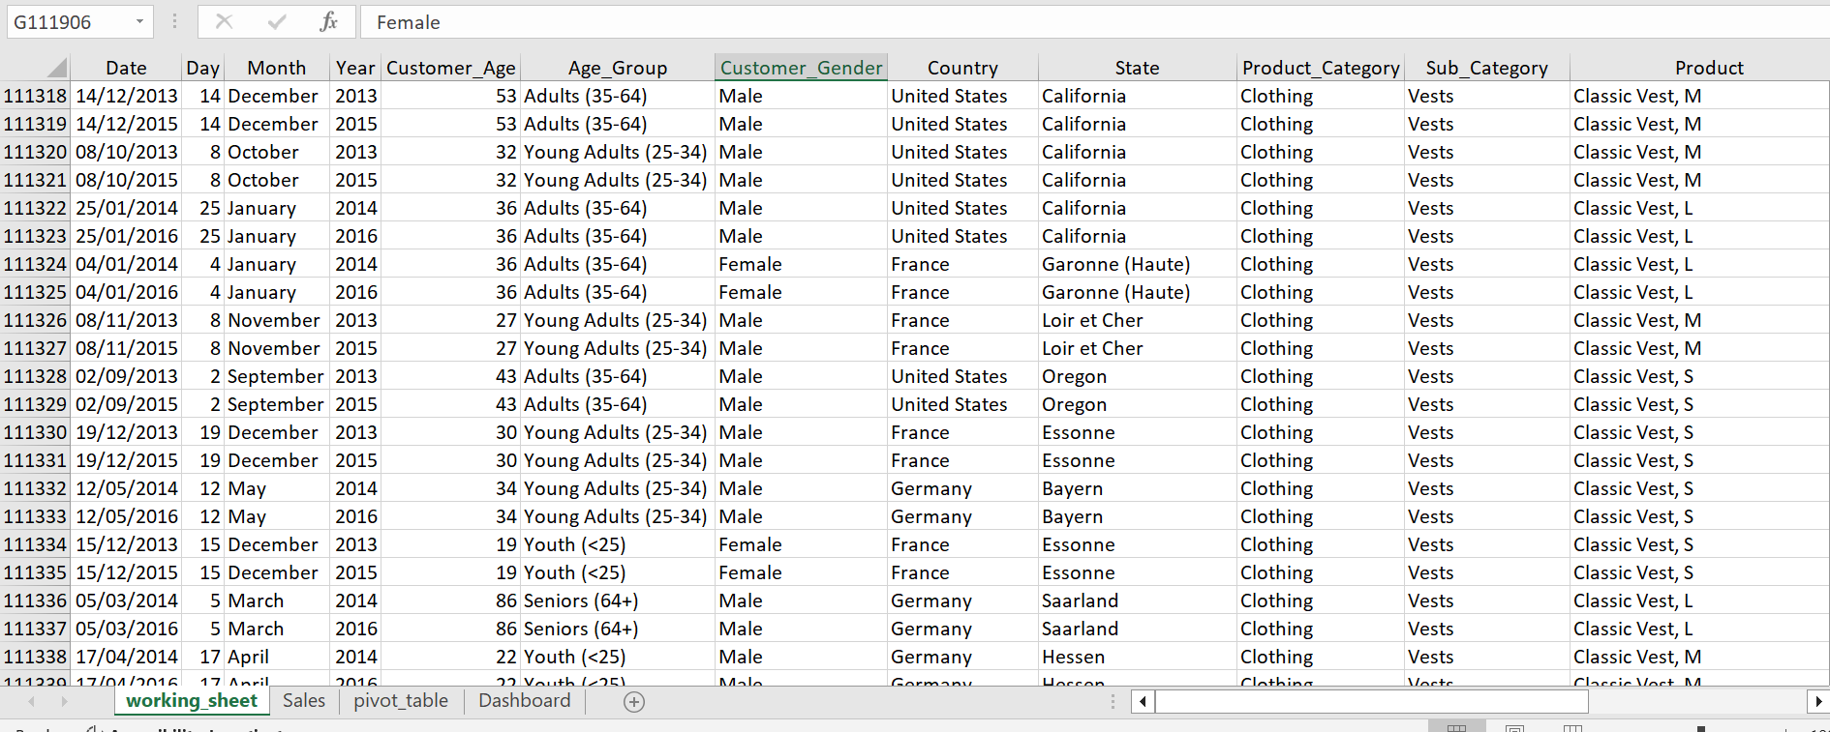
DATA CLEANING Deleted a total of 1000 rows of duplicate entry and standardize the customer gender column from M and F to Male and Female Respectively

Slide 7
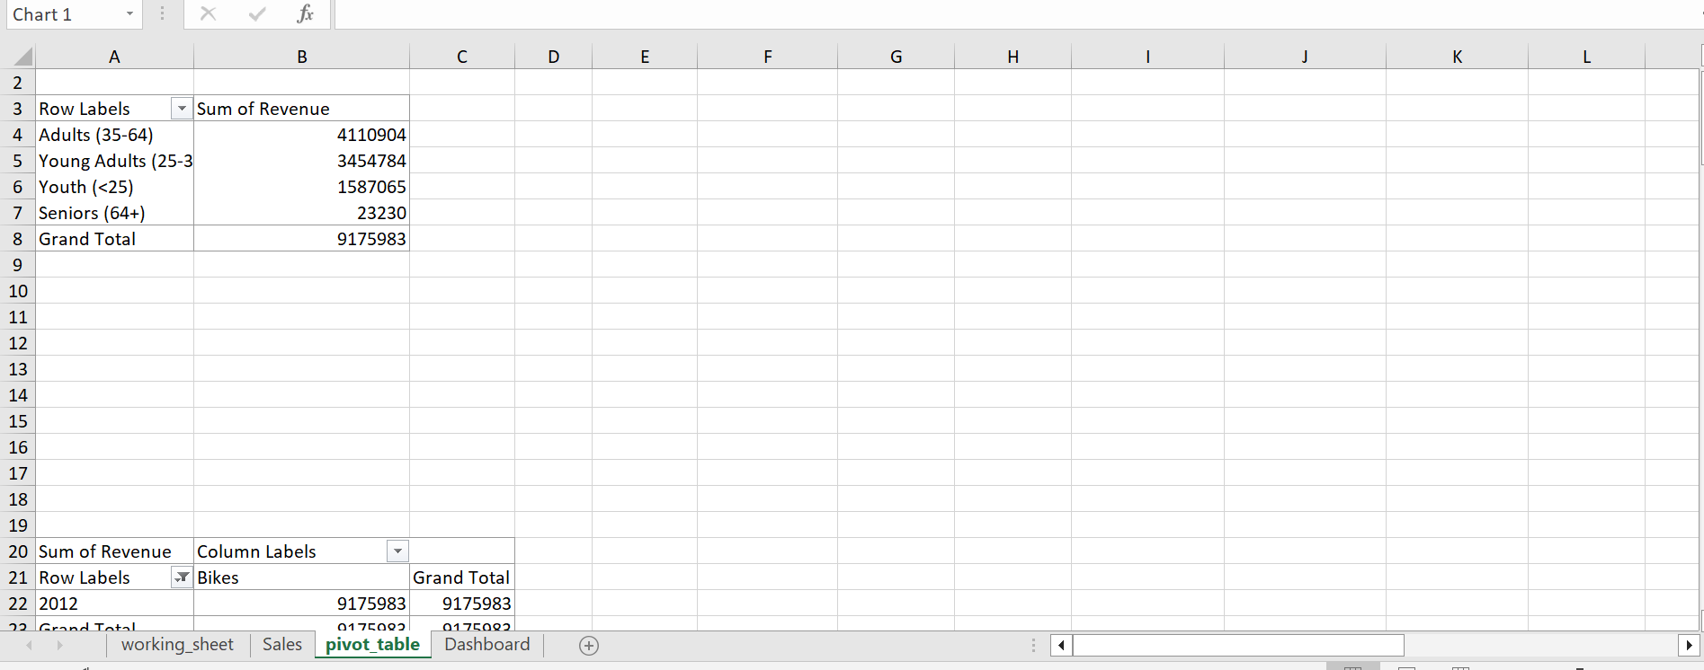
DATA ANALYSIS Calculation to determine trends and pattern using pivot table

Slide 8
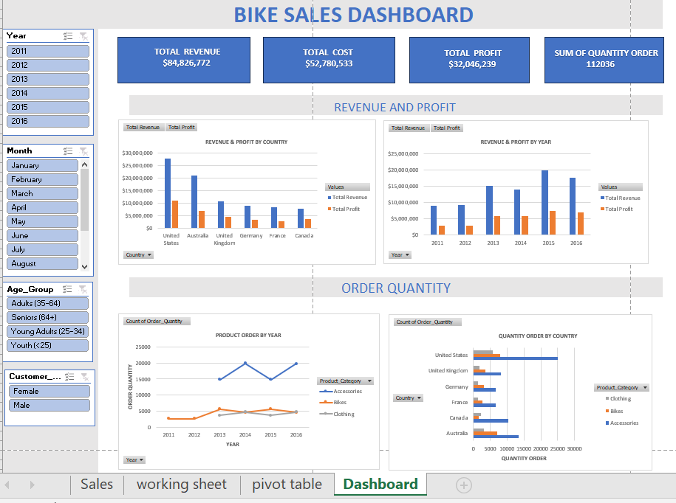
DASHBOARD
Notes:
Overall, this dashboard is a tool designed for in-depth analysis and monitoring of sales performance, customer demographics, and product trends in the bike sales industry, providing actionable insights that can help drive business decisions.

Slide 9
This image shows a comprehensive dashboard for bike sales data analysis. Here's a breakdown of the components shown in the dashboard: Top Metrics: Total Revenue: The aggregate revenue generated across all years. Total Cost: The aggregate cost incurred across all years. Total Profit: The calculated profit, derived from total revenue minus total cost. Sum of Quantity Order: The total number of units sold across all transactions. Revenue and Profit Charts: Revenue & Profit by Country: A bar chart displaying the revenue and profit for different countries, helping to compare performance across regions. Revenue & Profit by Year: A bar chart showing the annual revenue and profit, which helps visualize trends over the years.

Slide 10
Order Quantity Analysis: Product Order by Year: A line chart showing the order quantity for different product categories (Accessories, Bikes, Clothing) over the years. This helps track the popularity or sales volume trends of different products. Quantity Ordered by Country: A horizontal bar chart that compares the total order quantity among different countries, broken down by product category. Filtering Options: Year and Month: Allows filtering of data to display results for selected years and months. Age Group: Filters data based on different age groups (Youth, Young Adults, Adults, Seniors). Customer Gender: Provides options to filter the data based on customer gender. Tabs for Navigation: Various tabs like 'Sales', 'working sheet', 'pivot table', and the current 'Dashboard' tab indicate different views or sheets within the dashboard for further detailed analysis or raw data access.

Slide 11
SUMMARY​
MONEY INSIGHT
ORDER QUANTITY
SALES BY GENDER AND AGE CATEGORIES
Total revenue of 84,826,772 dollars and total cost of 52,780,539 dollars and total profit of 32, 046,239 dollars from 3 product categories of bike , accessories and clothing as derived from the dataset. Sales region into 6 countries with united states , Australia and United Kingdom the top 3 consuming country.
​
Quantity order based on country proves that there is high purchase of accessories over bike and clothing with united states, Australia and Canada been the top 3 country. Quantity orders by year proves that the sales of bike was from 2011 and slightly increases from 2013 to 2016 and sales of accessories id from year 2013 to 2016 with accessories sales higher than others
More revenue generated from the female for the first 2 years and this changes to male over the last 3 years with male having the highest revenue and quantity order. Throughout the 4 age categories , Adults having 49.94%, Seniors having 0.36%, Young adults having 35.92% and Youth 13.78% of the total revenue

Slide 12

Thank you
Miss Kolawole Olaitan Adeola
olaitankolawole5@gmail.com

